Slide 1
CCMC Fellows Presentation
EMIL (Electronic Medical Information Library Resources)
Searching Questions and Identifying Research
January 16th, 2018
Janice Lester, MLS
jlester1@northwell.edu
Tel 516-470-7071
Reference and Education Librarian - LIJ Health Sciences Library

Slide 2
Location: Research Bldg. C Level
Library Staff Hours 8.30 am – 6.30 pm
24/7 ACCESS AVAILABLE UPON REQUEST
Janice Lester, MLS jlester1@northwell.edu
Education and Reference Librarian Tel: 516-470-7071
Raquel Fereres, MIS Rfereres@northwell.edu.edu
Electronic and Web Librarian Tel: 516-470-7356
15 Computers.
Assistance with literature searches including systematic reviews.
Databases, online books and journals
Ability to order articles and books not available in our library.
Collection of older print books and journals
Renovation of library in 2017!

Slide 3
Objectives/Outcomes for this session:
1. Identify a clear structured searchable question.
2. Execute an appropriate search strategy to search the literature for specific types of study designs based on the topic.
3. Determine appropriate resources from EMIL (Electronic Medical Information Library) to answer background or foreground information questions.

Slide 4
Tips When Searching
Be Methodical
Leave yourself adequate time to search…But don’t spend too much time doing it
Document where you searched, what you searched and when you searched
Store all of your citations in the same place
(eg Endnote or Endnote Web) Endnote Desktop can be ordered from IT for the desktop
Seek help from a librarian when you need it.

Slide 5
Steps of Basic Research
1. Create an answerable research question
2. Break your research question into searchable components
3. Choose the database/s
4. Generate subject headings and synonyms
5. Execute your search and select limiters
6. Analyze your search results, modifying and re-executing searches as needed
7. Review the Articles

Slide 6
Background Versus Foreground: Experience Determines Need
Background Questions
- About conditions
Foreground Questions
- About choices

Slide 7
Create an Answerable Research Question based on your Hypothesis Know the difference between background and foreground questions.
Background Questions:
Ask for general knowledge about a condition or thing.
Have two essential components:
A question root (who, what, when, etc.) with a verb
A disorder, test, treatment, or other aspect of healthcare
Foreground Questions:
Ask for specific knowledge to inform clinical decisions or actions.
Usually have 3 or 4 essential components (PICO)
Patient and/or problem
Intervention
Comparative intervention (not always needed)
Clinical outcome

Slide 8
Break your research question into searchable components
PICO
Patient/Population – Includes age, race, sex, geography
Problem – Current health concern
Intervention – Exposure of interest
Comparison – Alternate exposure (if any)
Outcome – What is the desired outcome?
Does this mean that every research question can/should be answered this way?

Slide 9
Creating the Question
Create one sentence (elevator statement) that epitomizes what concept you are looking to search which includes PICO elements.
Does giving Prophylactic Acetaminophen to infants (age 2 months) after immunizations decrease sleep duration compared to a placebo?
What are our PICO Elements?

Slide 10
Bad Question
What is the best way or best practice to treat children with asthma?
Best how? Fewer asthma attacks? Less severe attacks? A treatment that is cheaper? Fewer side effects? Fewer adverse reactions with other medications?
What type of asthma? Chronic? Exercised Induced?
How are we diagnosing asthma and who is doing it?
Best compared to what? What type of treatment are we considering?
Is there a more specific age group that we are addressing?
Are we measuring any of these concerns? If so, how?

Slide 11
Good Question
Among young children with acute asthma exacerbation, is a single dose of IM dexamethasone comparable to five days of oral prednisolone for resolution of asthma symptoms?
More detail is usually better; not always possible, but generally better.

Slide 12
Selecting and Searching the Databases
Wait a minute…
Where did you say those EMIL databases and resources can be found?

Slide 13
Accessing EMIL from the Intranet

Slide 14
EMIL – LIBRARY PORTAL

Slide 15
Finding an article/book – How to request an article /book through Interlibrary loan and literature search

Slide 16
Up to Date/Dynamed mobile and CME
All resources alphabetically listed

Slide 17
Pediatric Care Online Includes point of care, quick reference, Redbook online Pediatric ‘drug lookup’, Textbook of Pediatric care, Bright futures, AAP clinical practice guidelines

Slide 18
Pediatric Care Online Point of Care Quick reference

Slide 19
AccessPediatrics is an online pediatrics education, training and point of care information resource featuring Rudolph's Pediatrics, other core resources, board reviews, multimedia etc.

Slide 20
PubMed Useful For the Following
When searching for the newest information (pre-publication)
Very obscure cases
Special types of articles (case reports, trials, meta-analysis, systematic review
Ability to limiting by specific factors eg females, age, language, publication type
Ability to download into Endnote or other reference managers
Seeking Higher Levels of Evidence and specific search filters

Slide 21
Back to Our Clinical Questions…
Find all of the searchable elements of the sentence. Then look up the appropriate subject headings and a few synonyms if there are. If you can’t find the exact subject heading, use keywords.
Remember that if you only use subject headings that you may miss some of the more current literature.

Slide 22
Our Question
Will providing patient education reduce admissions for head trauma caused by parental abuse or neglect of children?
PICO
PATIENT = Children
PROBLEM = Parental abuse
INTERVENTION = Patient Education
COMPARATIVE = No Action (In other Situations Watchful Waiting/Placebo)
OUTCOME = Reduce Head Trauma Admissions

Slide 23
How to find Subject Headings and Synonyms
Synonym generation
MeSH (Medical Subject Heading) Database
‘Pearl Growing’ – examining abstract for other terms
Plurals
Hyphenation
Different Spellings (British)
Narrow MESH Headings
Related article search

Slide 24
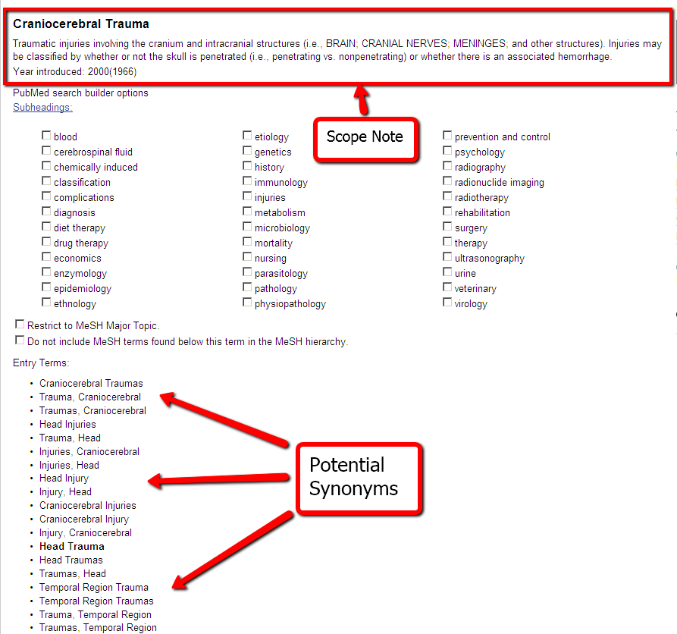

Slide 25
Generate Subject Headings and Synonyms
Will providing patient education reduce admissions for head trauma caused by parental abuse or neglect of children?
PICO
Children = This is a limiter option so we do not necessarily need a Subject term
Parental abuse = Child Abuse OR child neglect OR infant abuse OR child maltreatment
Patient Education = ‘Patient Education as Topic’ OR ‘parent education’ OR ‘education of patient’ OR ‘patient education’
Head Trauma= Craniocerebral Trauma OR head injuries OR head trauma OR head injury OR shaken baby syndrome

Slide 26
Database Filter and Study Design
Before you search the PICO elements of your clinical question, it’s important to know:
What TYPE of question are you asking?
What is the best STUDY DESIGN to search for to find evidence to answer your clinical question?

Slide 27
Clinical Queries on main page of Pubmed https://www.nlm.nih.gov/bsd/disted/pubmedtutorial/020_570.html

Slide 28
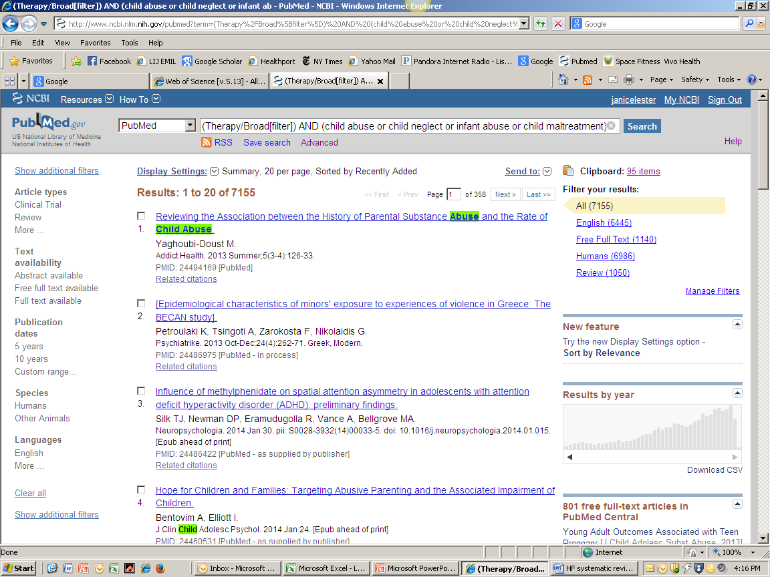
Limit Your Search

Slide 29
Register for My NCBI to personalize Pubmed, filter your search, create alerts, save references, etc.
https://www.nlm.nih.gov/bsd/disted/pubmedtutorial/070_010.html

Slide 30
Analyze Your Search Results
This may be the point where you discover that you either have too many results or too few (or off topic results).
Too Many - Apply more or stricter limiters, look for higher levels of evidence or make search terms more specific.
Too Few (or off topic) – Remove any limiters, execute a general PubMed search, add search terms or generalize search terms (think drug class as opposed to specific drug)

Slide 31
Read the Abstracts/Review Articles
At this point you should be able to discover some basic information about the results by looking at the titles and abstracts. Look to see what type of results you have, and whether it suits your purpose.
Does this mean that you have found everything ever written because you searched in Pubmed?

Slide 32
Of course not.
In most cases, if you are doing searching that is clinical or research based you will not be doing yourself a disservice by only searching Pubmed.
If, on the other hand, you are writing a literature review, systematic review, or meta-analysis you may also need to search other databases ie. Web of Science, Scopus, Embase,, Cochrane library, CINAHL (a nursing/allied health database).
Google Scholar is an excellent option to start one’s search but is sometimes not that easy to filter for Evidence based medicine resources or be sure the source is peer review

Slide 34
Other Library Resources
Visual DX- a visual diagnostic decision tool
Web Of Knowledge or Scopus-extensive database with citation metrics and conference proceedings. Includes Web of Science and access to Endnote Web
Embase – Strong coverage of Europe, Asia, Australia includes conference proceedings. Main strength is excellent drug information and pharmacovigilance
Pubshub - contains comprehensive details on peer-reviewed medical journals and academic conferences for those interested in scholarly publishing or presentations.

Slide 35
Micromedex
Micromedex is the formulary drug source for Northwell Health providing real time surveillance, information on drugs, diseases, toxicology and a comprehensive resource for patient and consumer education the mandated drug source
Micromedex Apps on Apple®, Android® and Windows 8® Devices
Free Micromedex® Drug Reference for Internet Subscribers
Drug Reference app for iPhone/iTouch and iPad
The Free Micromedex Drug Reference for Internet Subscribers app for Apple, Android, and Windows 8 devices is available for FREE for Micromedex customers.
You can access these apps via the iTunes® App Store (Apple devices), Google Play® (Android devices) or the Windows Store® (Windows 8 devices).
Android users only: the app is called Free Micromedex Drug Reference in the Google Play store.
You can activate the app by following the simple instructions below.
Simple instructions for installation:
Step 1
Visit the iTunes App Store (Apple devices), Google Play Store (Android devices) or the Windows Store (Windows 8 devices) and search for "Micromedex."
Step 2
From all the Micromedex app results, select Free Micromedex Drug Reference for Internet Subscribers (Apple devices and Windows 8 devices) or Free Micromedex Drug Reference (Android devices). You may be prompted to enter your Apple, Google or Windows ID.
Step 3
The app should download directly to your device. (If you visited the iTunes App Store on your PC rather than your device, you may have to sync your device to iTunes on your PC, in order to load the app onto your device.)
Step 4
Open the app on your device. Enter the password 2ANeze to begin using Free Micromedex Drug Reference for Internet Subscribers. The password is case-sensitive. Please enter it exactly as it appears here.

Slide 36
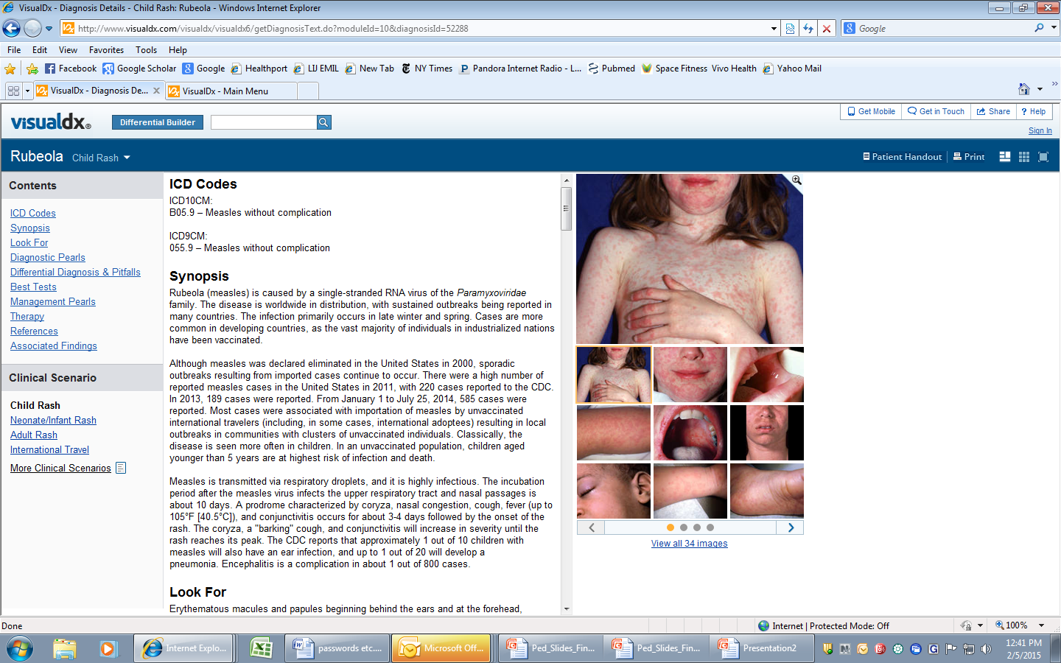
Visual DX Differential Builder-by lesion – linked to Up to Date
Ability to Limit by age group, oral, eye, pulmonary, specific exposures, international travel etc.

Slide 37
Web of Knowledge Includes Web of Science, Journal Citation Reports and Endnote Web
Citation metrics for VR Bonagura

Slide 38
Web of Science – citation metrics

Slide 39
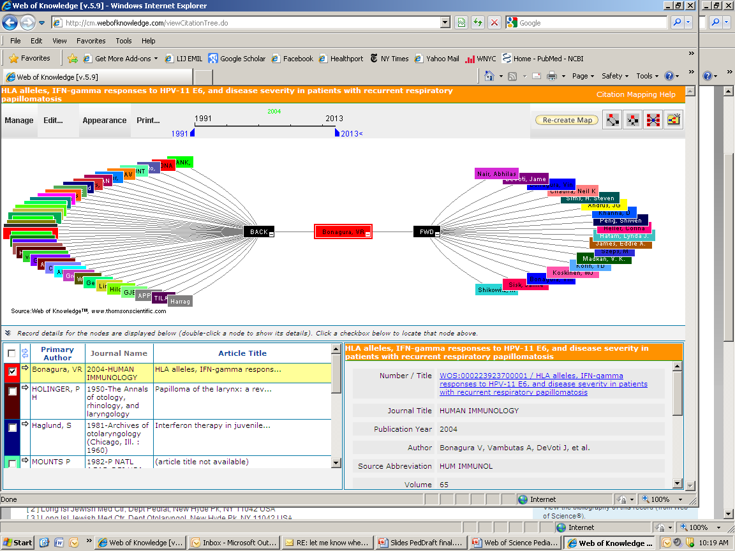
Web of Science- Citation map –

Slide 40
Endnote and Endnote Web
For Endnote Desktop version, call IT at x7272 for the software installation on your work computer.
Desktop version allows you to ‘cite while you write’, change reference styles, ability to download from most databases including Google Scholar, deduplicate your references.
Endnote Web www.myendnote.web
To access, register in Web of Science on library’s main page. Access to Endnote Web from anywhere
Ability to download and manage your references from any database including Google Scholar
Ability to share references with anyone who has Endnote Web

Slide 41
Mobile Resources: A-Z List
http://libguides.hofstra.edu/c.php?g=323470&p=2323021
Includes Access Medicine, Clinical Key, DrawMDseries, Pediatric Care Online, Visual Dx, Medibabble translator, and much more.
Instructions on access for which mobile device, cost and how to access through the library

Slide 42
More efficient WIFI NSLIJHS-WAB
Go to Settings
Look for ‘other’ WIFI
Type in NSLIJHS-WAB
You will be prompted for userid/pw
Join

Slide 43
ALWAYS REMEMBER TO BE IN THE INTRANET TO ACCESS FULL TEXT EITHER FROM WITHIN HOSPITAL OR REMOTELY! ONLY THEN WILL THE LINKS TO THE FULL TEXT BE AVAILABLE TO YOU. THIS INCLUDES CINAHL, GOOGLE SCHOLAR, PUBMED AND OTHER DATABASES

Slide 44
Perceptions can be Deceiving

Slide 45
Evidence based medicine explained to the music of Coldplay
http://www.youtube.com/watch?v=QUW0Q8tXVUc

Slide 46
“can bring you back 100,000 answers.
A LIBRARIAN can bring you back the right one“
Neil Gaiman

